Slide 1



Project Stage 4
CPSC 481 - Fall 2020
TA: Hessam Djavaherpour
Team J - Minh Hang Chu, Edward Mah, Yunfan Yang, Nicolas Urrego

Slide 2









Project Idea – Online Reserving and Ordering Mobile App
Sign in as a guest or have an account
Select date, time, number of people, and seat preference
View a list of restaurants grouped by types
View restaurants information
Preview restaurants menus before reserving
Pre-order food items and invite other people to a reservation
Leave reviews for a restaurant

Slide 3

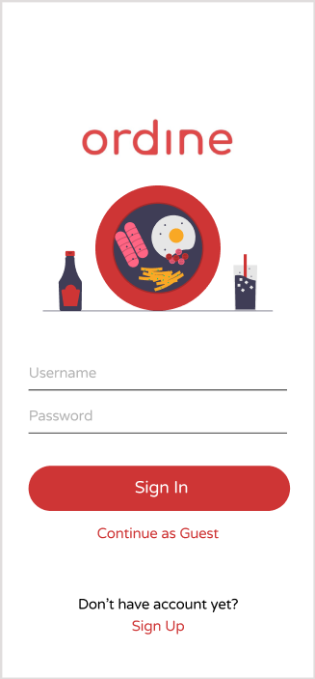
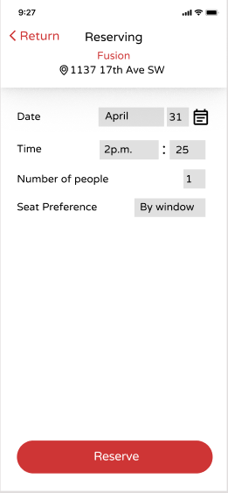
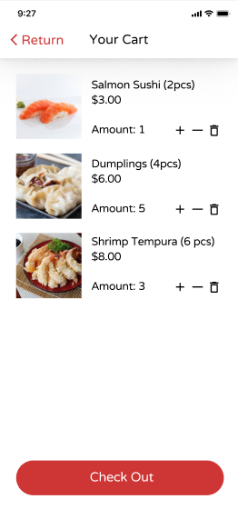
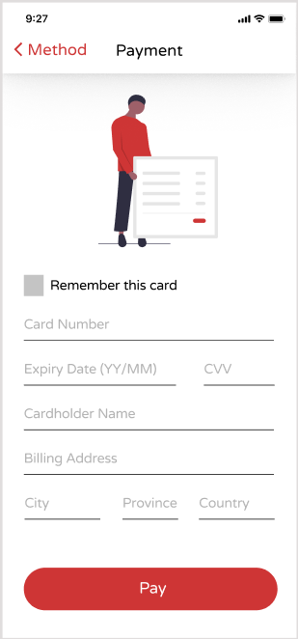
Prototyped Tasks / Prototyping software

Slide 4
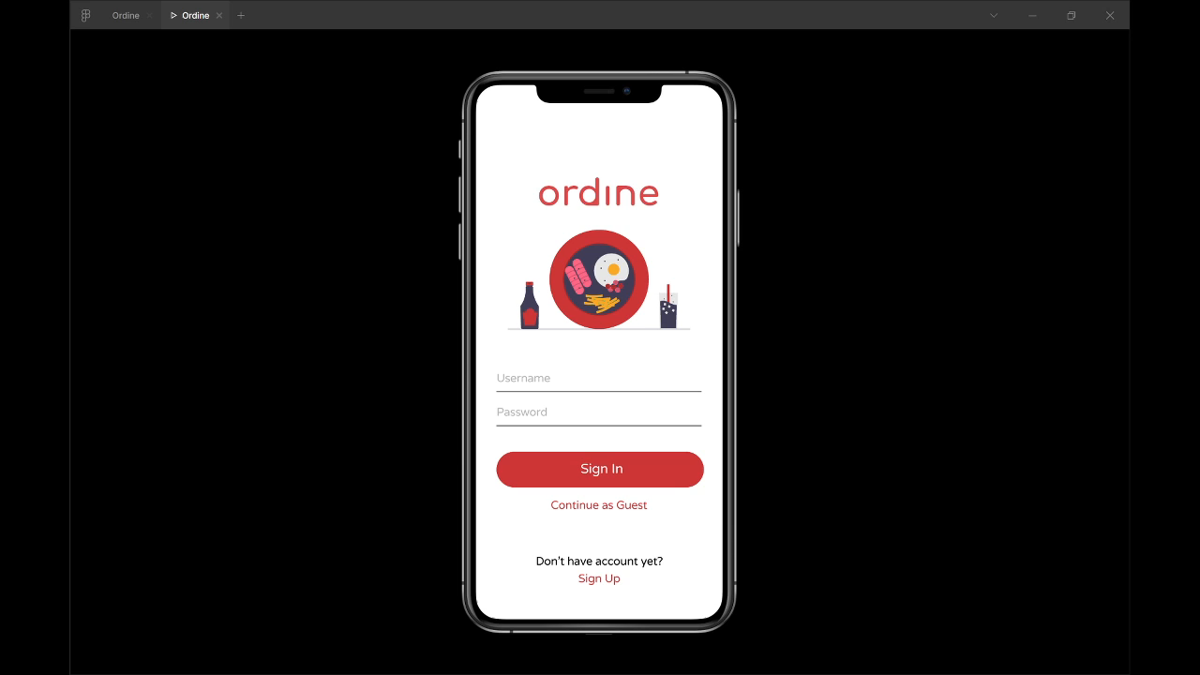
Demo

Slide 5
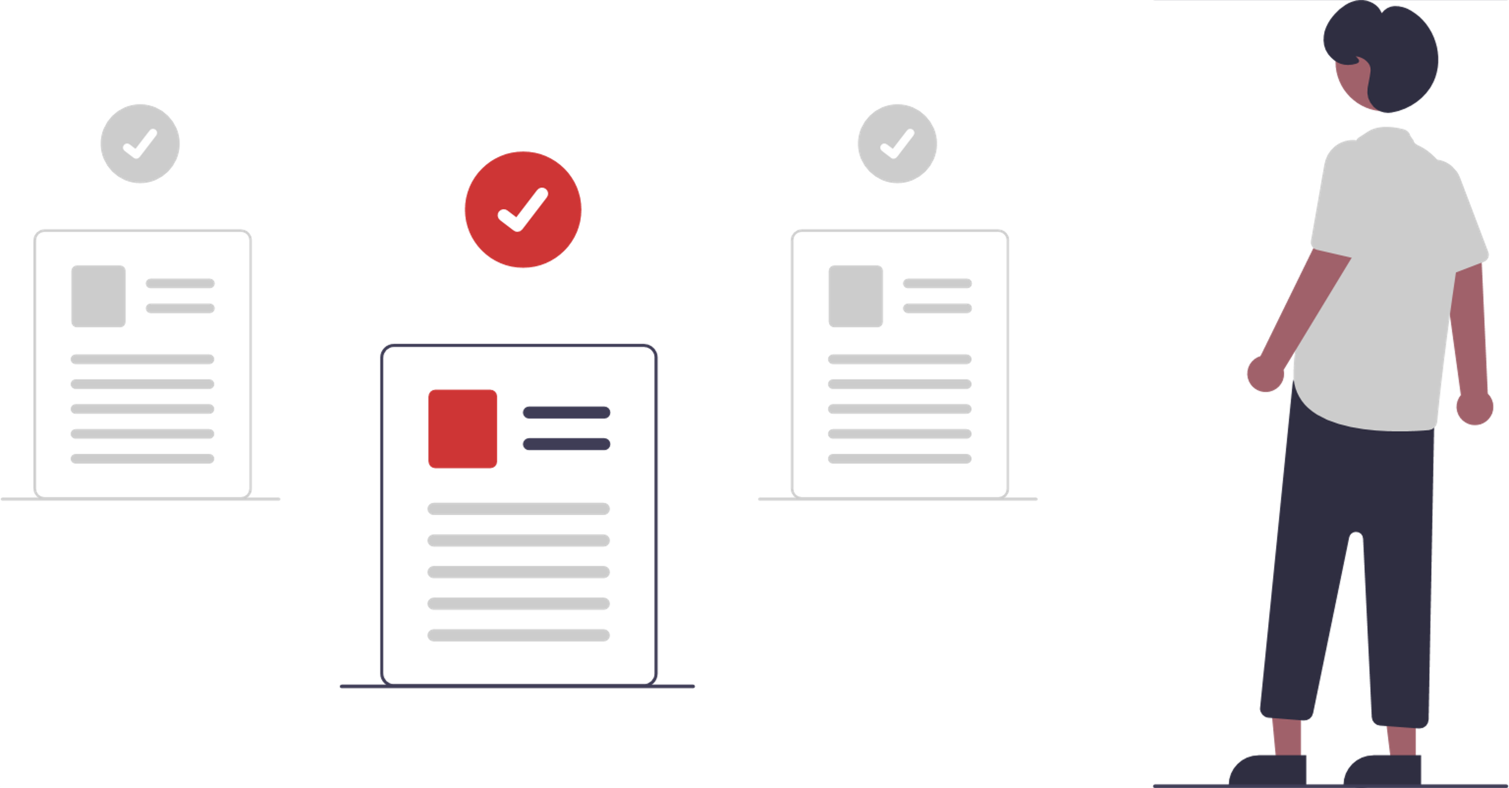
Heuristic Evaluation Process
Rule of Thumb | Is this rule being applied? How so? | Is this rule violated? How so? | How can this rule further improve usability, utility and desirability?
1. Visibility of system status | Yes. Such as when a payment is made and when the systems asks if u want to delete a reservation | When trying to order there without making a reservation first users are unable to know that they have to make a reservation first | When users know the current system status, they learn the outcome of their prior interactions and determine next steps. Predictable interactions create trust in the product as well as the brand.
2. Match between system and the real world | The navigation bar. Has the symbols that users should be familiar with | The icon of date has a calendar for calendar view in reservation but it is also the same icon for the reserve section in the nav bar | It’s easier for users to learn and remember how the interface works. This helps to build an experience that feels intuitive.
3. User control and freedom | Almost every page has a clear back button | Users who may accidentally press a icon on the navigation bar Have no clear back button to go back instead they have to click the nav bar again | Exits allow users to remain in control of the system and avoid getting stuck and feeling frustrated.
4. Consistency and standards | Has the typical login page along with login in with third party services. Consistent color design most of the time | Some buttons such as the buttons Payment are different color to the rest of the system or not corresponding with what they usually are | Users do not have to wonder whether different words, situations, or actions mean the same thing.
5. Error prevention |  | A undo button when an item is added to cart would be helpful instead of having to go to cart to remove. There are no popups in case someone wants to delete something. | eliminate error-prone conditions
6. Recognition rather than recall | By adding the food item image in the cart as well users do not have to remember what the name of the food is. The recent searches also helps |  | Interfaces that promote recognition reduce the amount of cognitive effort required from users.
7. Flexibility and efficiency of use | Having a favorites and recent searches for users. A filter system for the restaurant view | No save filter option for users if they want to filter the same way again | Flexible processes can be carried out in different ways, so that people can pick whichever method works for them.
8. Aesthetic and minimalist design | The restaurant browser menu is designed with only the important parts needed | When a restaurant is clicked the information presented is a lot. | Interfaces should not contain information which is irrelevant or rarely needed.
9. Help users recognize, diagnose and recover from errors | No option to clear all current filters if needed. | Even with the error prevention popups if a user deletes there is no quick undo. Users must reserve again | These error messages should also be presented with visual treatments that will help users notice and recognize them.
10. Help and documentation | The system is self-explanatory | No help page | Help and documentation content should be easy to search and focused on the user's task to ensure usability
Reviewer 1 Rank: 4 9 5 10 6 2 1 3 7 8
Reviewer 2 Rank: 4 8 5 10 9 3 7 1 2 6
Final ranking: 4 5 10

Slide 6
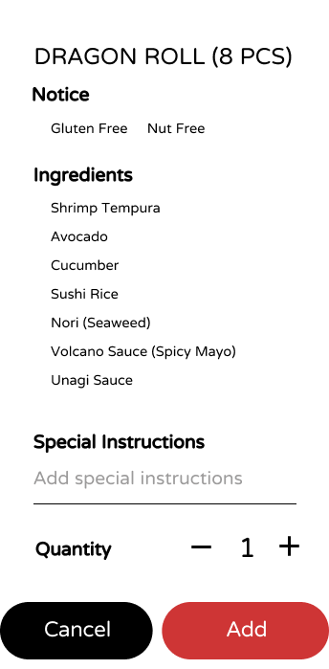
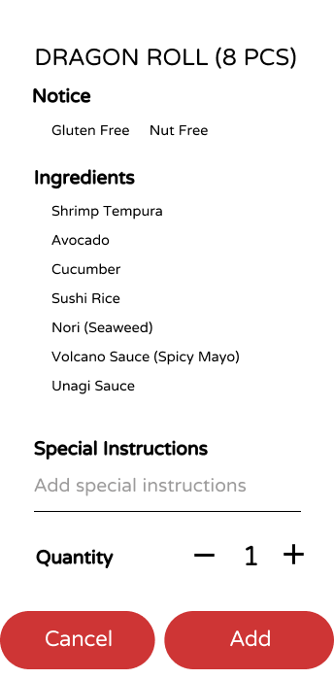
Color Changed on Button

Slide 7
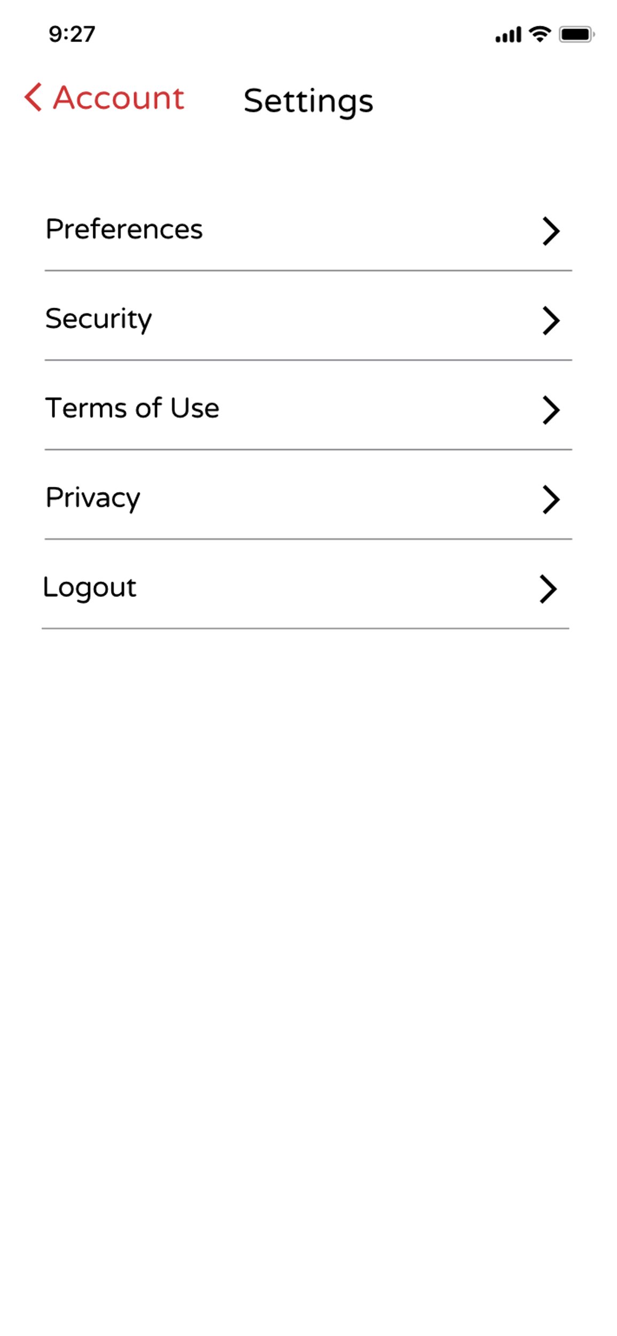
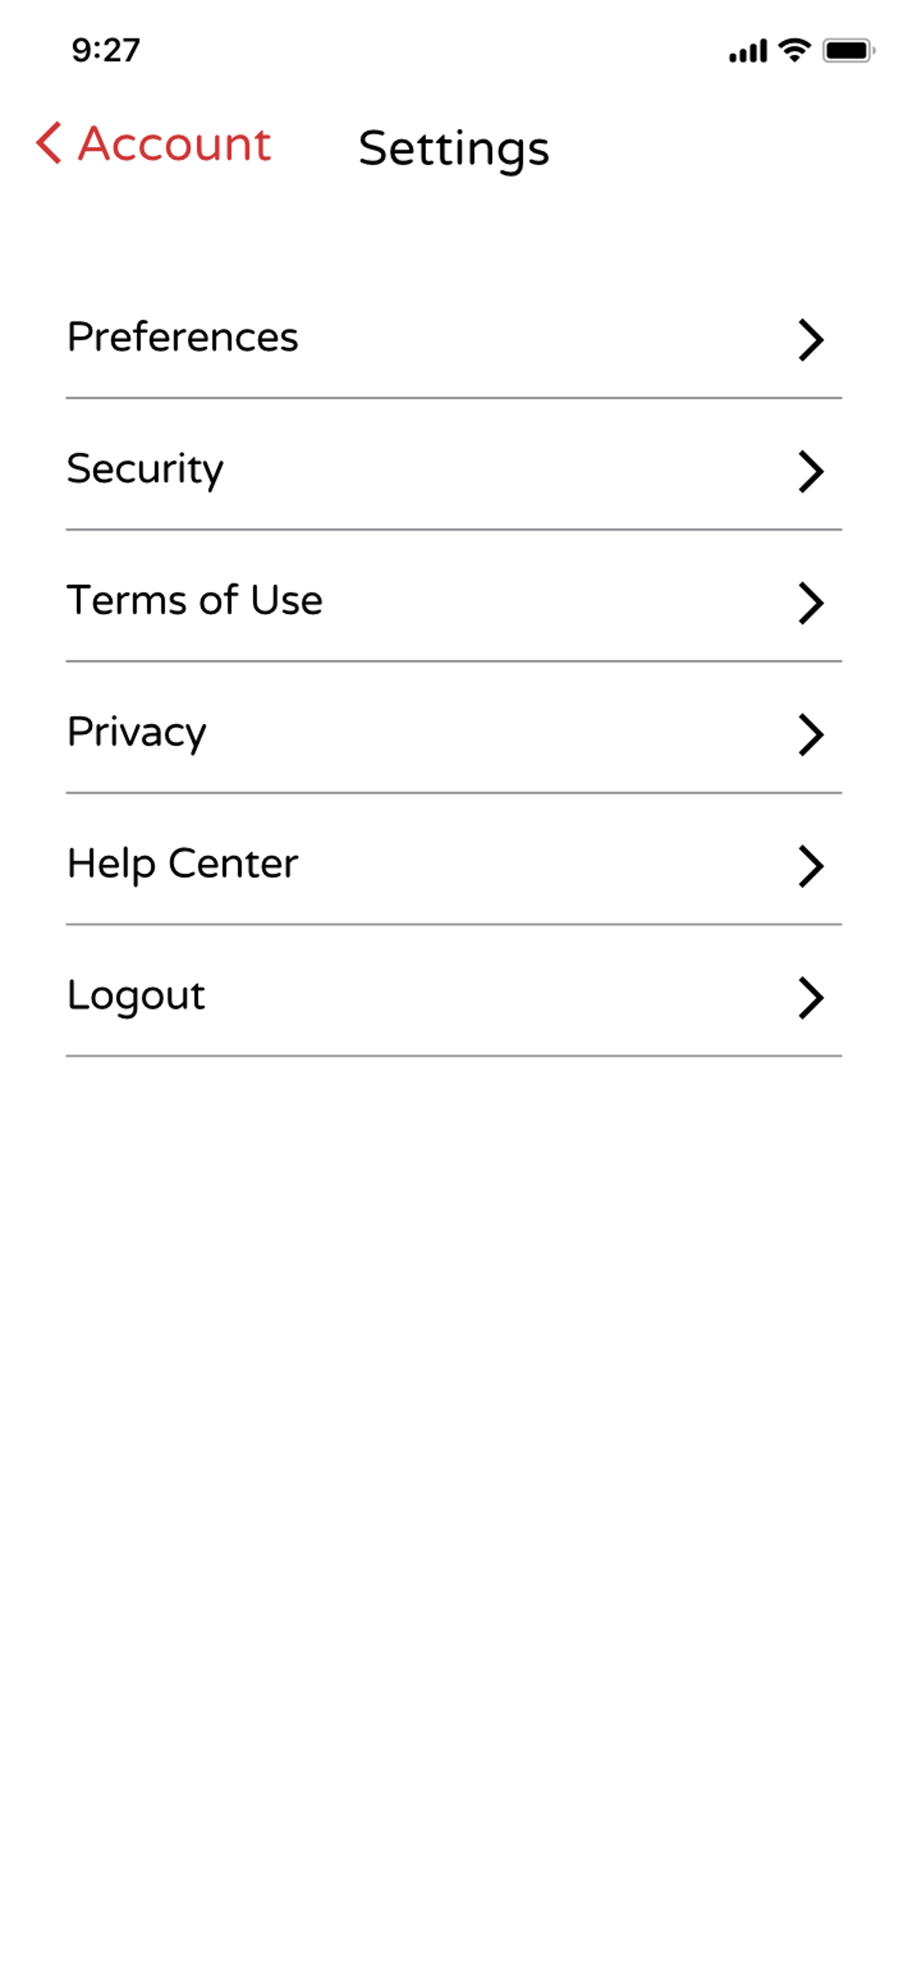
Help Center

Slide 8
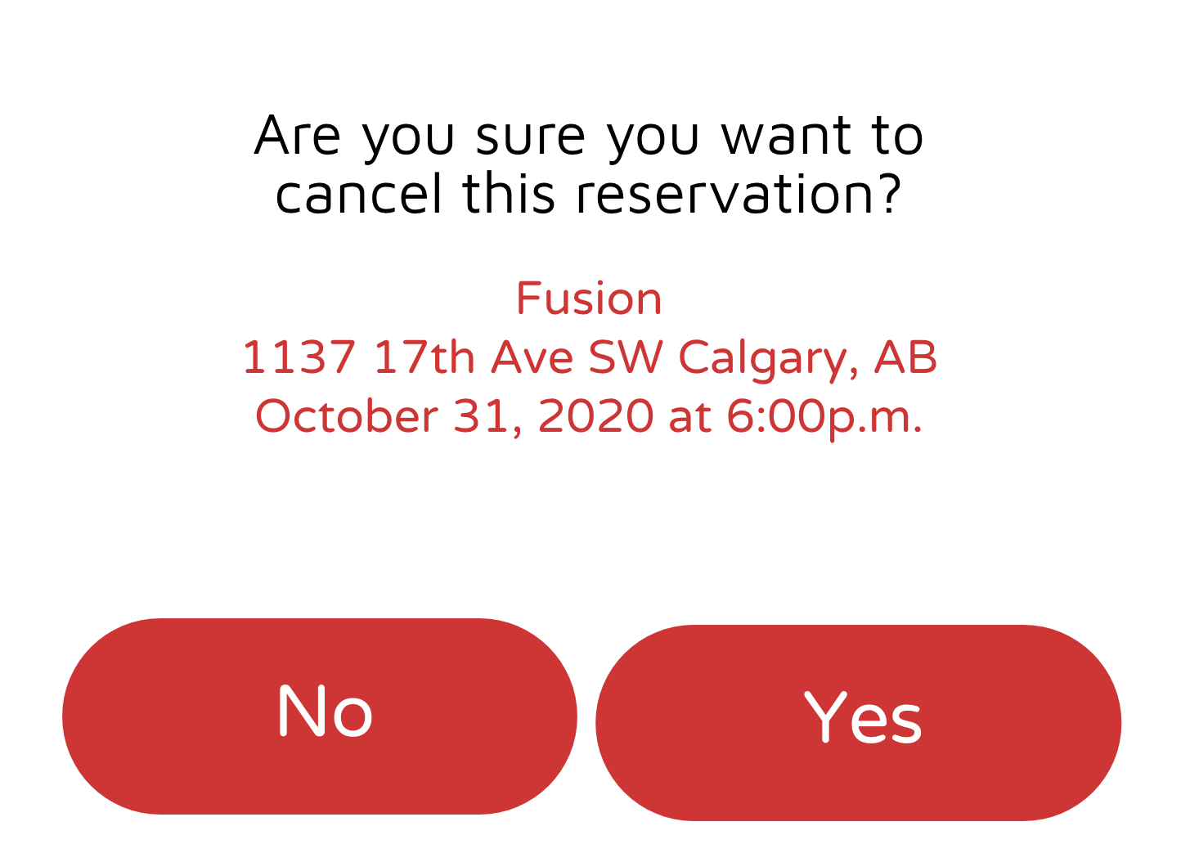
Changes Error Prevention

Slide 9


Reflection
What we learned
What went wrong
How to use Figma
The heuristic evaluation process
Figma frames and editing
Functional text box

Slide 10




Stage 5 Plan
Add intractability to certain buttons
Making final prototype more realistic
Implement additional user tasks

Slide 11

Thanks for watching

